Slide 1
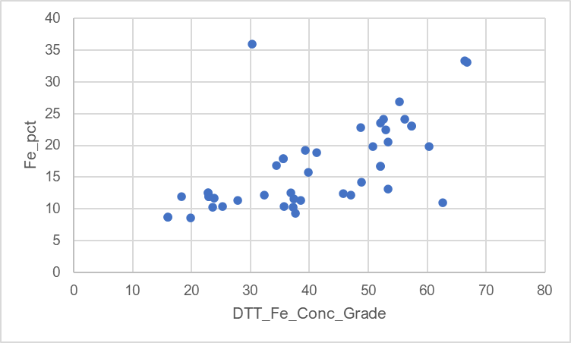
outlier
[4a3-21-504DD@130-132]

